Slide 1
ESTIMATING MORTALITY
IN
FISH STOCK ASSESSMENT
Joseph DeAlteris
University of Rhode Island
Department of Fisheries and Aquaculture
Kingston, RI 02881

Slide 2
Presentation Outline
Introduction to fish stock concept and fisheries
Description of total mortality - instantaneous versus percent annual losses
Description of natural mortality
Description of fishing mortality
Estimating total mortality and fishing mortality
Estimating natural mortality
Applications of tag-recapture experiments in fisheries:
    Estimating population size from one-time release and single census
    Estimating exploitation rate from a one-time release and single census or recaptures in a series of years from a single year release
Summary

Slide 3

Schematic Diagram of Inputs and Losses to a Stock
Recruits (R)
Natural mortality (M)
Fish Stock
Growth (G)
Fishing mortality (F)
Stock Size = R + G - (M + F)

Slide 4
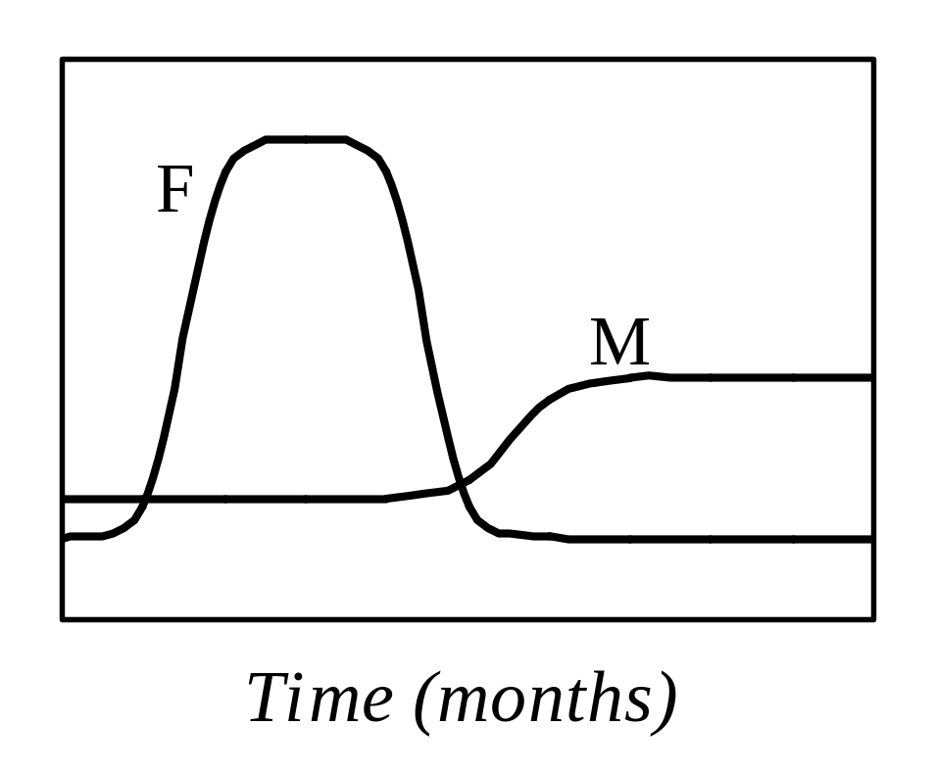
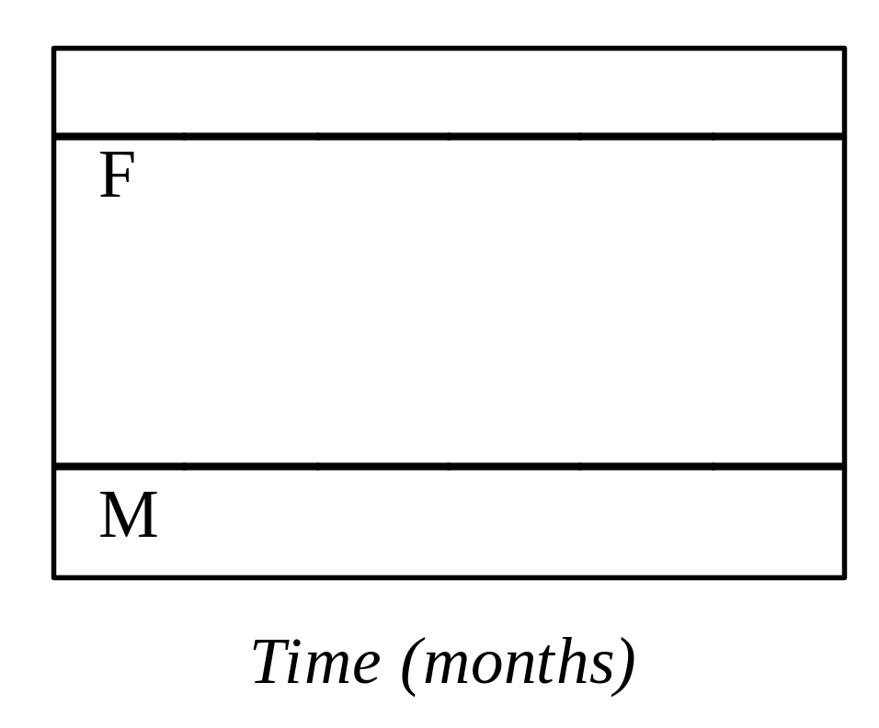
Types of Fisheries
Type 1 Fishery Type 2 Fishery

Slide 5
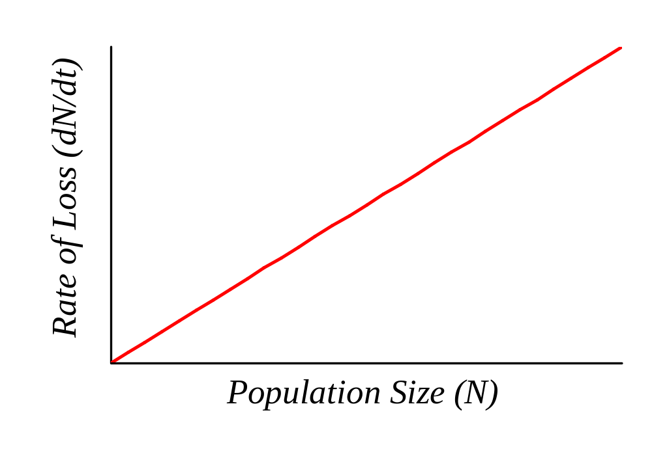
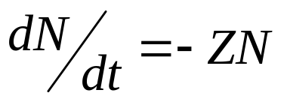
Survival Differential Equation
Slope =
Instantaneous Rate (Z)

Slide 6

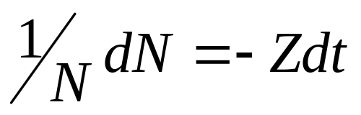
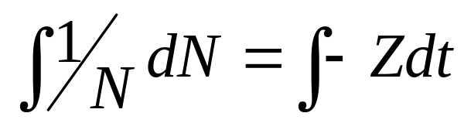
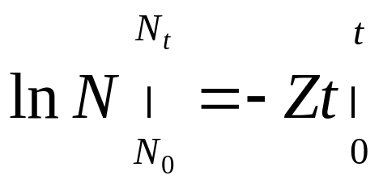
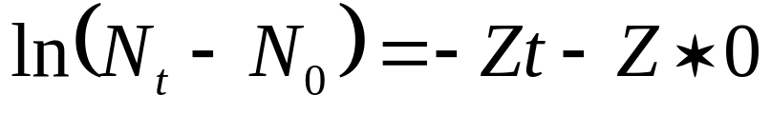
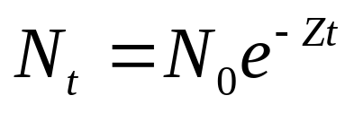
Solution to Survival Differential Equation by Separation of Variables

Slide 7
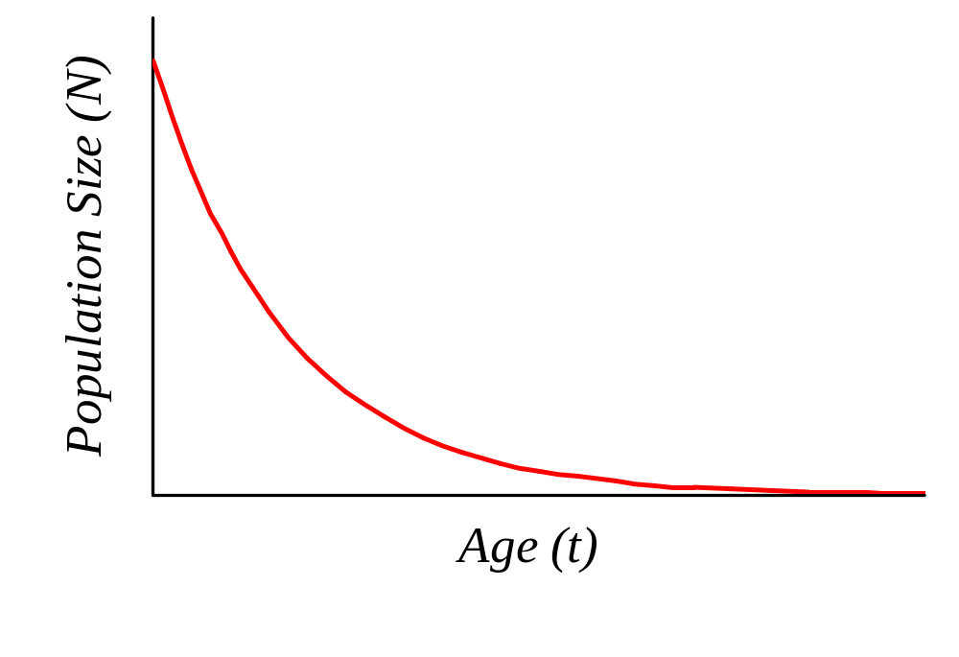
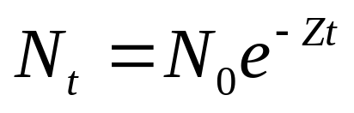
Survival Equation

Slide 8
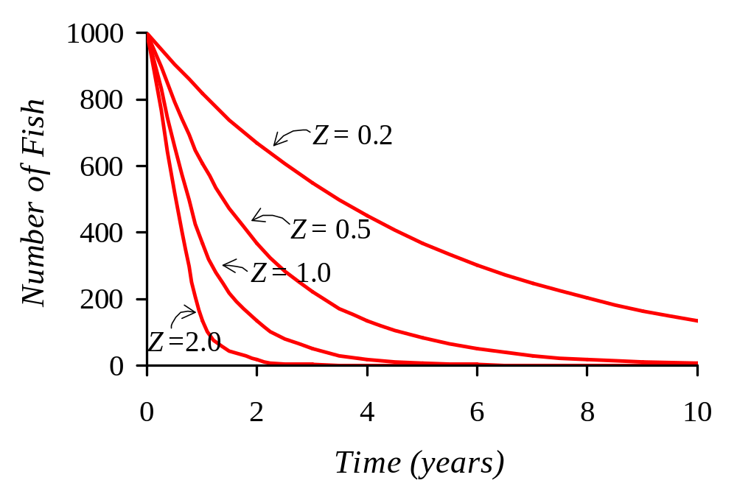
Survival Functions, for Z = 0.2, 0.5, 1.0, and 2.0, with recruitment N₀ = 1000 fish

Slide 9
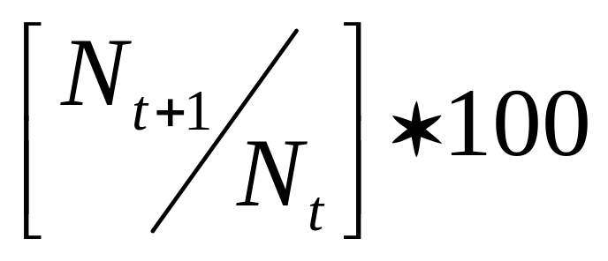
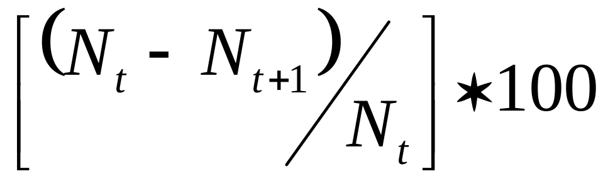
Percent Annual Survival =
Percent Annual Mortality =

Slide 10
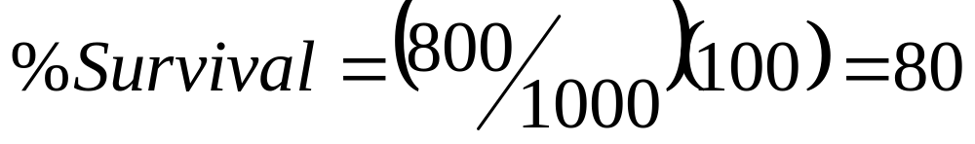
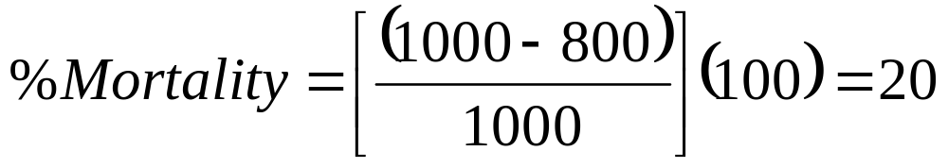
Example
If N_{t} = 1000 and N_{t+1} = 800,
then loss after 1 year is 200.

Slide 11
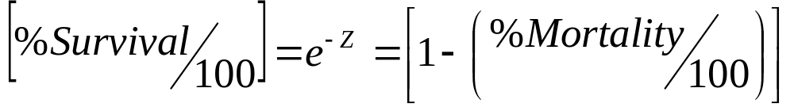
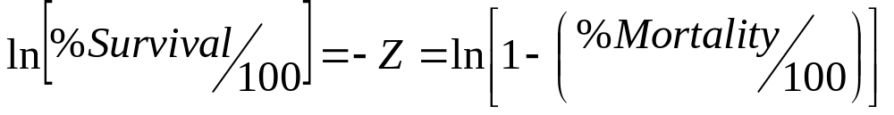
Convert between Instantaneous Rate and Annual Percent Loss

Slide 12
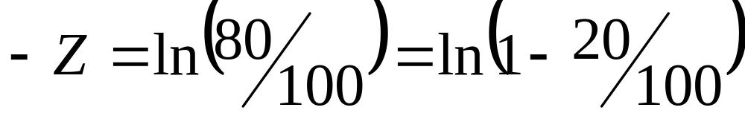
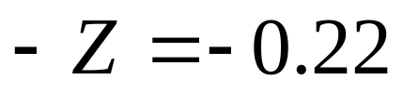
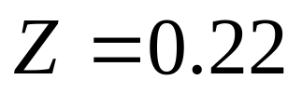
Example
If % Survival is 80, and % Mortality is 20, then Instantaneous Mortality Z is:

Slide 13

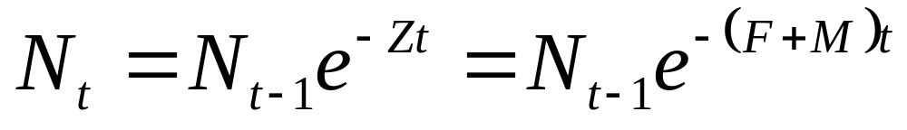
Total Mortality (Z) = Natural Mortality (M) +
Fishing Mortality (F)
Expressed as: Instantaneous Rates

Slide 14
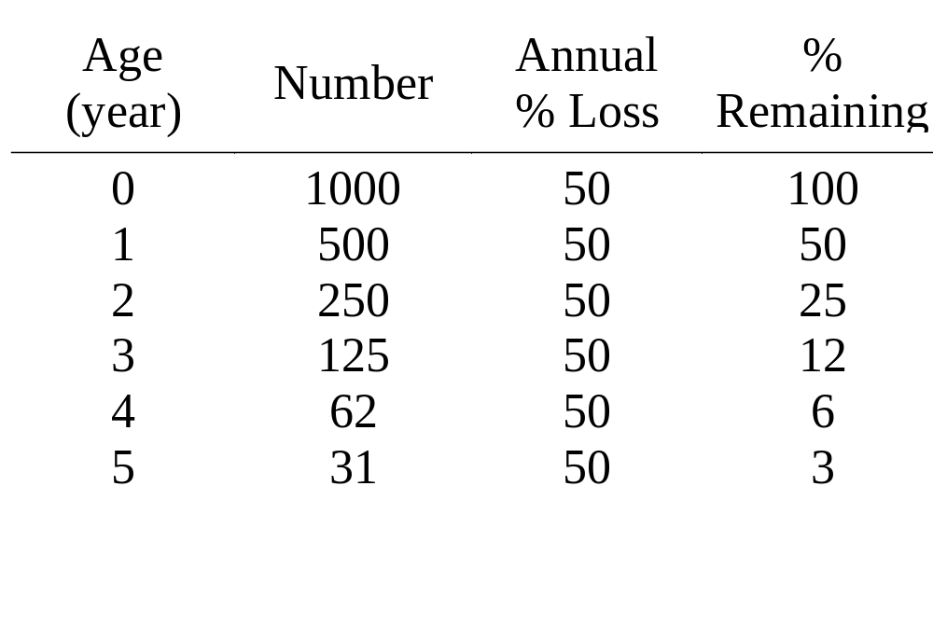
Instantaneous Natural Mortality of 0.7
Note: Life span is when cohort number is reduced
to less than 5% of initial number

Slide 15
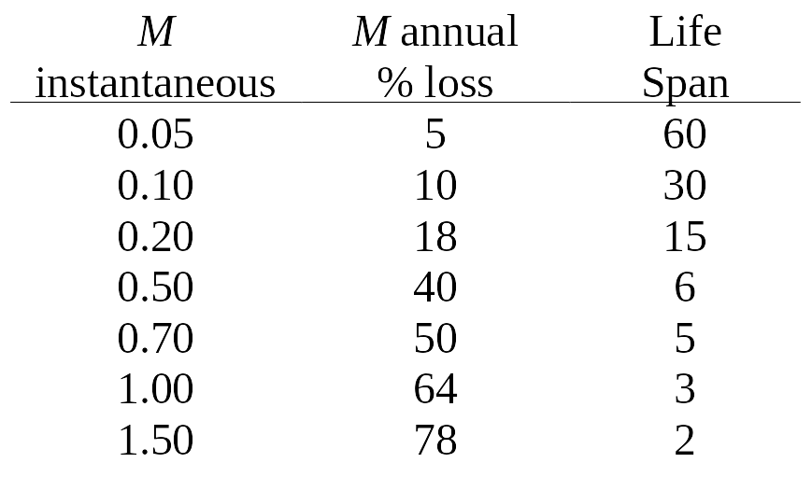
Natural Mortality
M = 0.2 → Long-lived species, 15 years
M = 0.7 → Short-lived species, 5 years

Slide 16
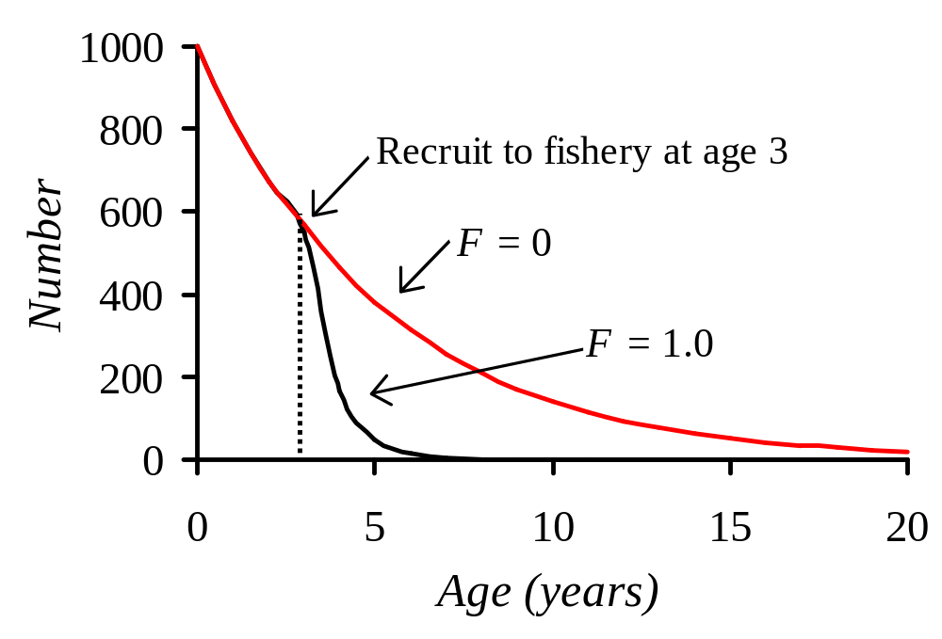
Fishing Mortality

Slide 17
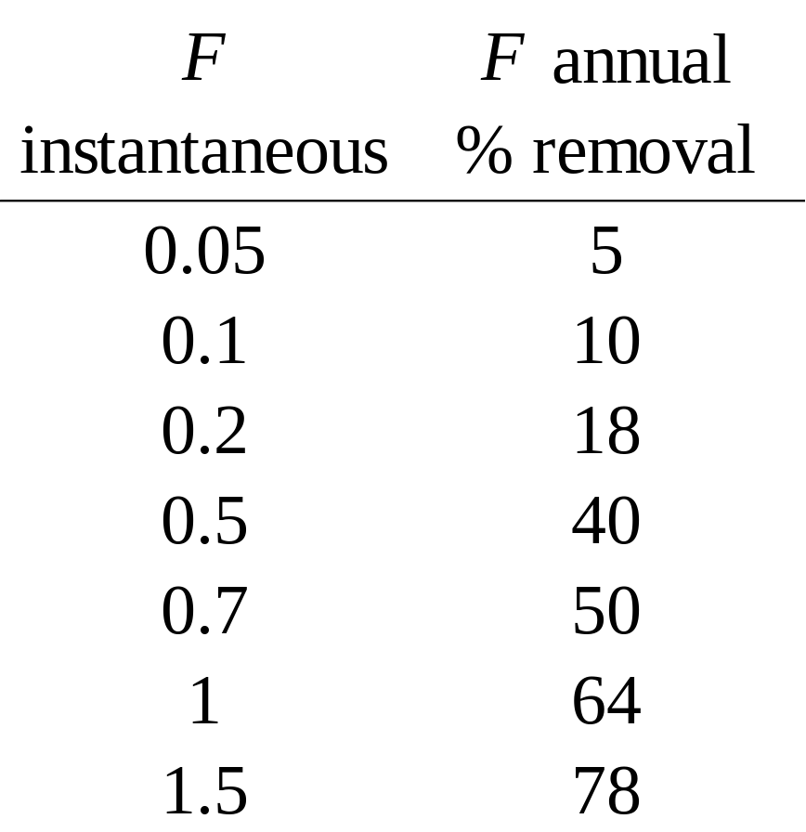
Fishing Mortality (assuming M is small)
F = 0.1→ 0.5 - moderate rates of fishing mortality appropriate for long-lived species
F = 0.5 → 1.0 - high rates of fishing mortality appropriate for short-lived species

Slide 18
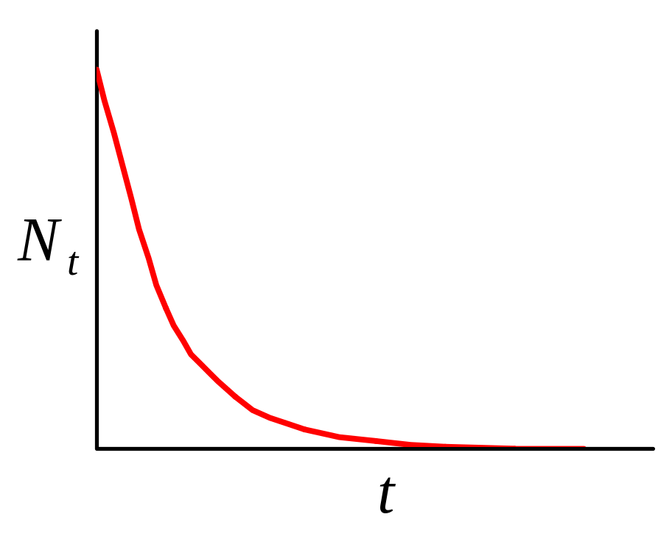
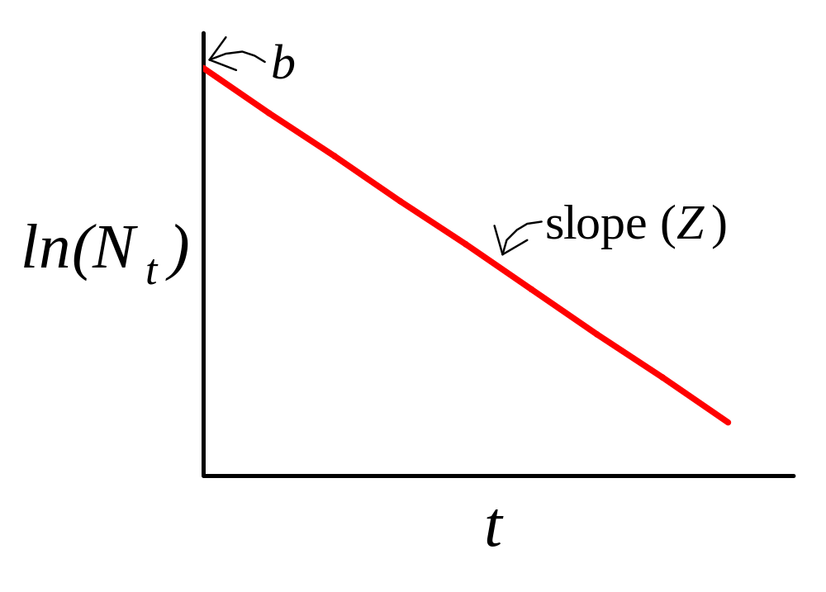

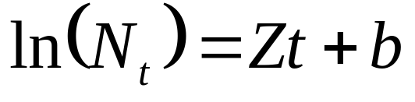
Estimating Total Mortality: Catch Curve Analysis

Slide 19
Notes: CCA requires an index of stock abundance
Usually follows a single cohort or age class with time using survey data (CPUE) where sample effort is constant, or fishery catch data if fishing effort is assumed constant
Can be used on single stock sample from survey data or fishery catch data if annual recruitment is assumed constant, and survey or fishing effort is assumed constant

Slide 20
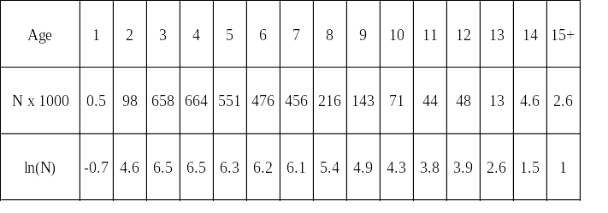
Catch Curve Analysis for Atlantic Striped Bass (landings and discards) in 1996

Slide 21
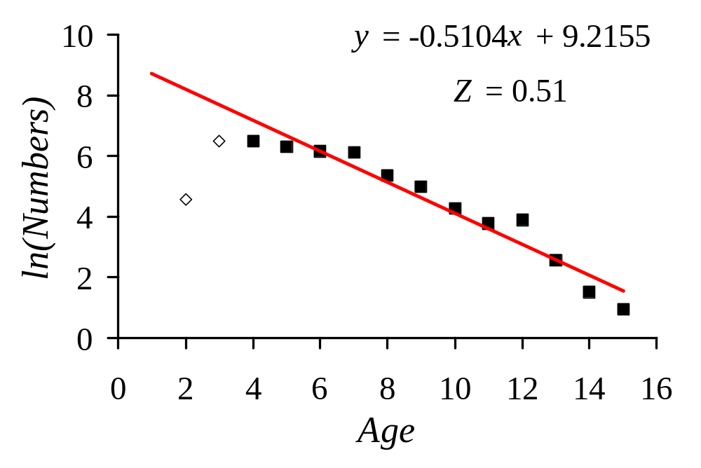
Catch Curve Analysis

Slide 22
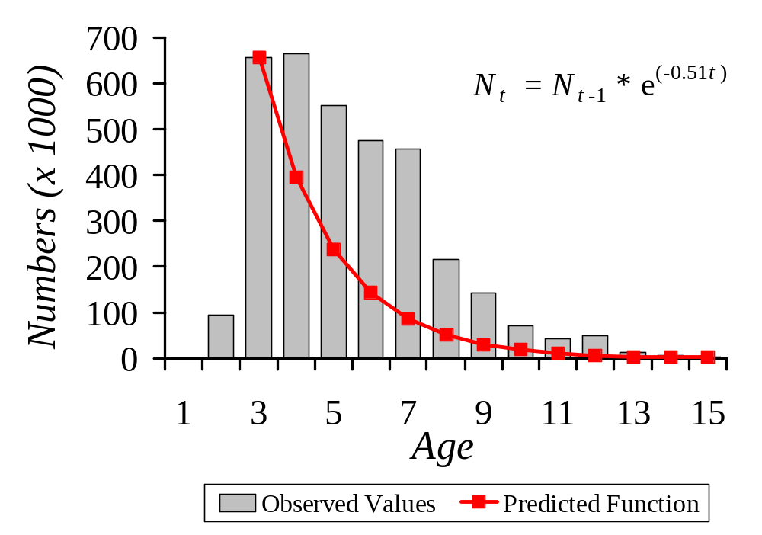
Observed and Predicted Population Size

Slide 23
Results
CCA analysis suggests average total mortality in 1996 of fully recruited cohorts is 0.51.
If M is assumed at 0.15 - 0.20.
F is estimated at 0.31 - 0.36.
Fisheries management target is F = 0.31.

Slide 24
Assumptions or Limitations of
Catch Curve Analysis
(1) S, F, and M are independent of age and time, and assumed constant;
(2) Samples randomly taken from all age groups (non-age selective sampling);
(3) All age groups recruited equally to the fishery.
(4) Sample or fishing effort remains constant.

Slide 25
Estimating Natural Mortality (M)
(1) Total mortality (Z) and effort (f) data
(2) Life history data

Slide 26
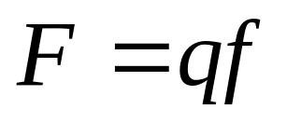
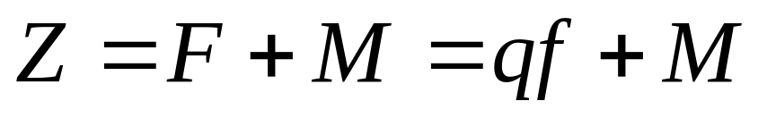
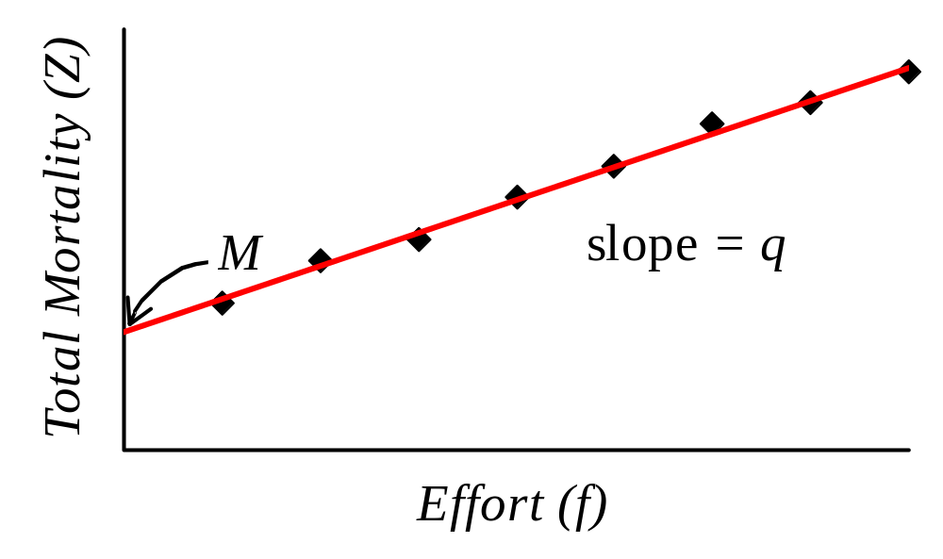
Estimating M from Z and f
Where q is catchability

Slide 27
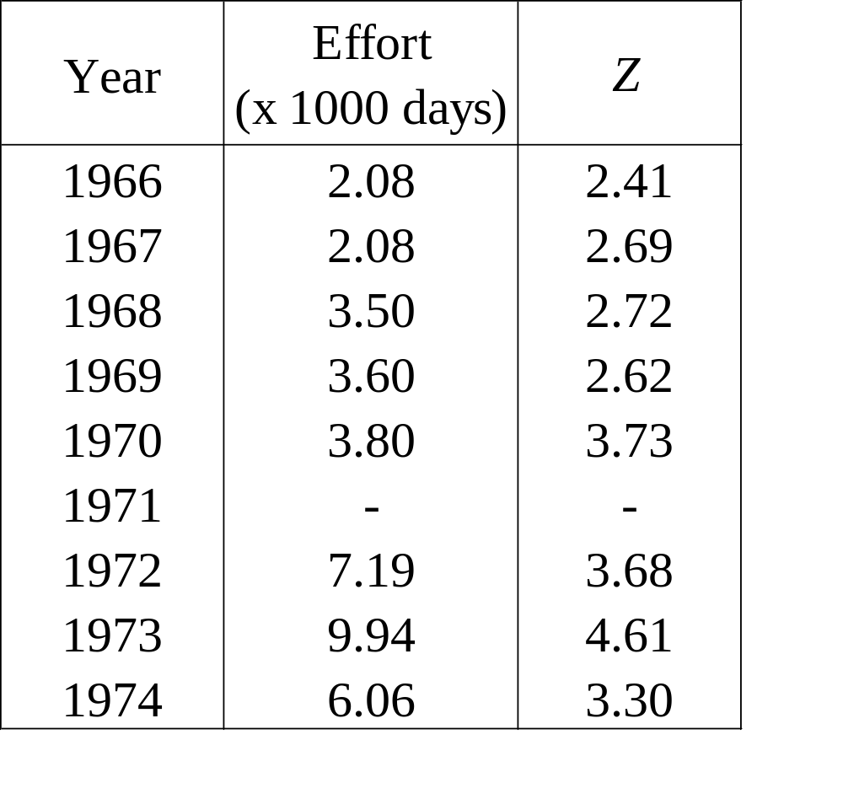
Total Mortality and Effort Data for kingfish off the Coast of Thailand from 1966 to 1974

Slide 28
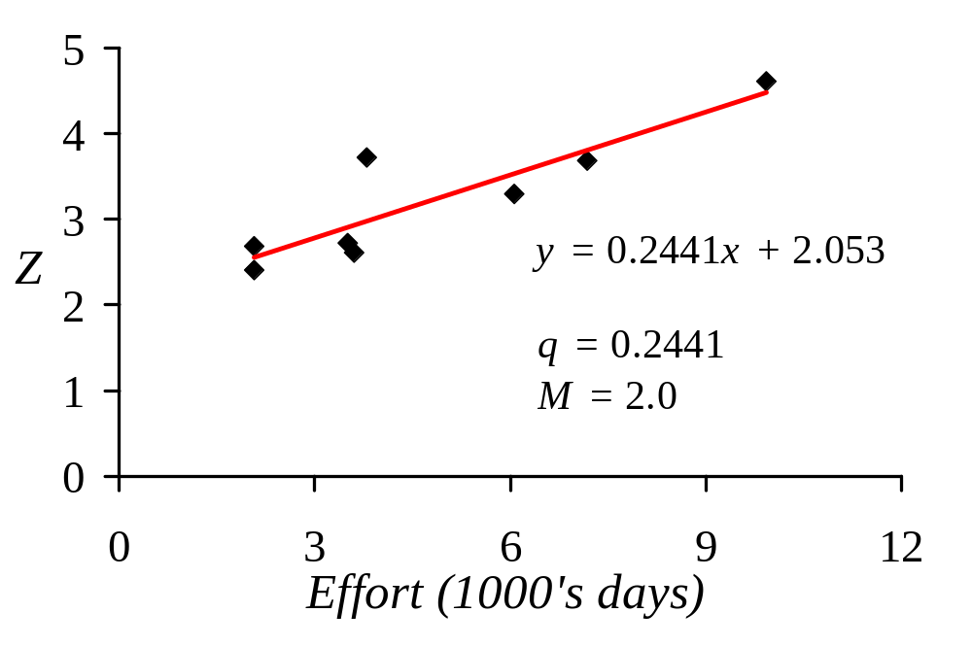
Plot of Z versus f for kingfish fishery

Slide 29
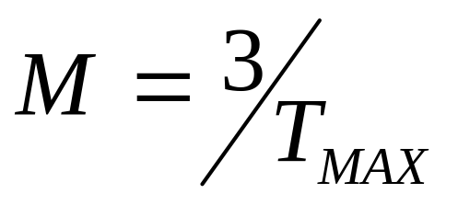
Estimating M from Life History Data (Hoenig 1983)
Where T_{MAX} is the maximum age or longevity

Slide 30
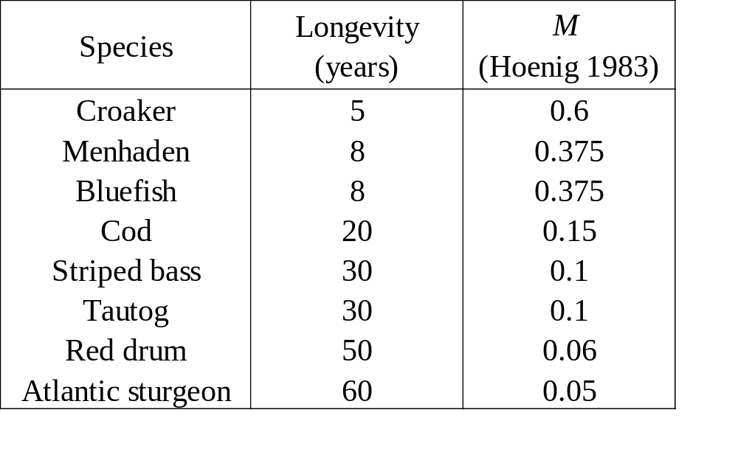
Values of Natural Mortality Derived Using Hoenig (1983)

Slide 31
Application of Tag-Recapture Experiments in Fisheries
(1) Population Size
(2) Rate of Exploitation
(3) Survival Rate
(4) Rate of Recruitment
Note: Many assumptions utilized in applications of these analyses

Slide 32
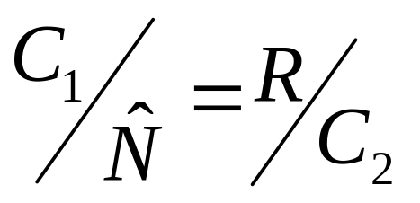

Estimating Population Size from a One-Time Release and Single Census
= Recapture Rate = RR
Where: = estimated population size
C₁ = number of fish initially captured and tagged
C₂ = number of fish subsequently captured
R = number of tagged fish recaptured

Slide 33
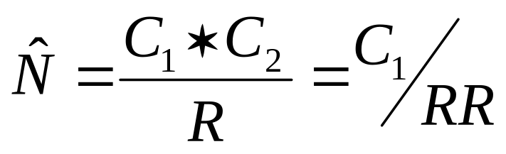
Rearranging this equation:

Slide 34
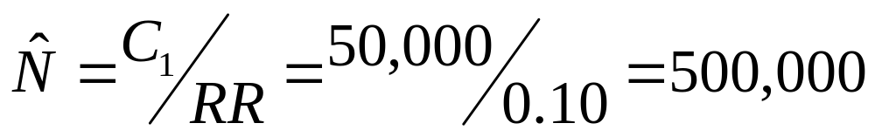

Legal-sized Lobster V-notching Project in RI Sound
C₁ = 50,000 lobsters released into RI Sound with V-notches over a one month period
RR = 10% or 0.10 at the end of 1 month
lobsters in area
with assumptions that is in equilibrium:
recruitment = fishing
immigration = emigration

Slide 35
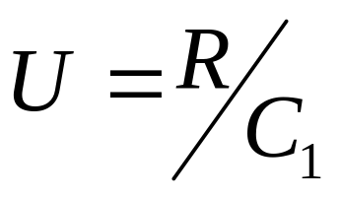
Estimating Exploitation Rate from a One-Time Release and Single Census
= Exploitation Rate
Where: U = estimated exploitation rate
C₁ = number of fish initially captured and tagged
R = number of tagged fish recaptured
Note: U is the proportion of annual loss due to fishing

Slide 36
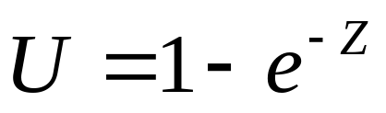
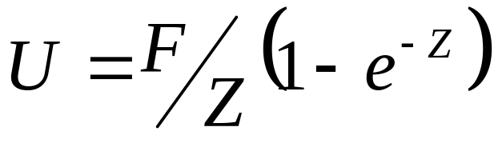
Exploitation Rate Converted to Instantaneous Rate for 1 Year Period
For Type 1 Fishery
For Type 2 Fishery

Slide 37
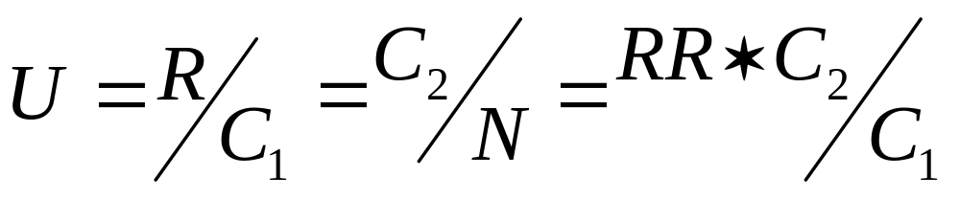
Legal-sized Lobster V-notching Project in RI Sound
Therefore must know either R or C₂ to estimate exploitation rate.

Slide 38
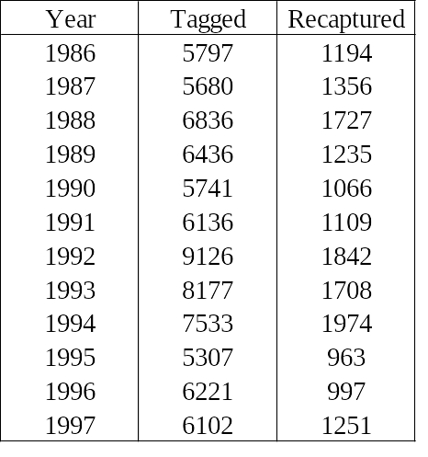
NUSCO data on tagged and recaptured predominantly sublegal lobsters in eastern L.I.S. from 1968 to 1997
Estimate U and F for these predominantly sublegal lobsters assuming a Type 2 fishery and M = 0.15?

Slide 39
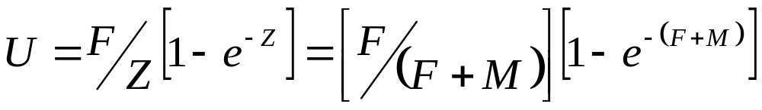
Basic Equations

Slide 40
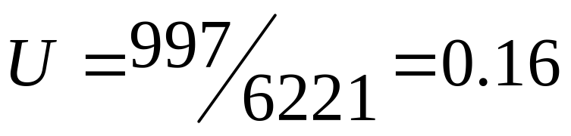
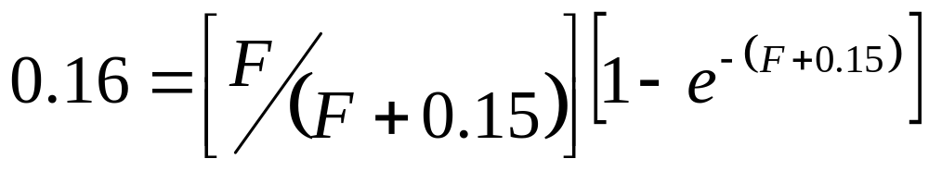

Example of Solution for 1996
Exploitation Rate =
Fishing mortality found using an iterative solution technique:

Slide 41

Recaptures in a Series of Years from a Single Year Release
Where: NT_{T} is number of tagged fish remaining in the population at time T
NT₀ is total number of fish tagged initially
F is fishing mortality rate
M is natural mortality rate
T is time in years.

Slide 42

Number of tagged fish captured in a given year
Where NR_{T} is number of tagged fish recaptured in
a given year
And as in CCA, by plotting the ln (recaptures) against time in years, total mortality Z is estimated.

Slide 43


Estimating Total Mortality from Annual Tag Returns

Slide 44

In Narragansett Bay, RI, 1000 winter flounder are tagged and released in the winter of 1990. Returns of tagged fish in four subsequent years are as follows:
Assume M = 0.30, and determine F over the period.

Slide 45

Ln(recaptures) versus Time for Tagged Winter Flounder

Slide 46
Thus, for Narragansett Bay winter flounder during the period 1991 to 1994, total mortality (Z) was 1.8. Assuming natural mortality (M) is 0.3, then F is 1.5, an extremely high rate of fishing mortality.

Slide 47
Summary
Mortality expressed as instantaneous rate or annual % loss
Total mortality (%) = [100 - Survival (%)]
Z = F + M
CCA is used to estimate Z, and F = Z - M
M is estimated from Z and f, or from life history data
Tag-recapture data is used to estimate N, Z, and F

Slide 48
Additional Examples

Slide 49

Weakfish caught by NEFSC autumn bottom trawl survey were aged by applying annual age-length keys from pooled commercial and research samples to survey caught fish. Catch-at-age (expressed as CPUE) for the 1985 and 1990 year classes is shown below. Estimate total and fishing mortality for the two different years, assuming M = 0.25.

Slide 50

For both years, solve for Z using the Catch Curve Analysis equation where a is the negative of total mortality (Z) and X is time in years.

Slide 51

1985 Data

Slide 52

1985

Slide 53
y = -1.5924x + 2.6576 if a = -Z then
Z = 1.59
Given
M = 0.25 then Z = F + M
F = Z - M
F = 1.34

Slide 54

1990 Data

Slide 55

1990

Slide 56
y = -1.1321x + 0.791 if a = -Z then
Z = 1.13
Given
M = 0.25 then Z = F + M
F = Z - M
F = 0.88

Slide 57
The following data are taken from the Cooperative Striped Bass Tagging Program, conducted by the U.S. Fish and Wildlife Service and the Atlantic States Marine Fisheries Commission. The purpose of the program is to monitor mortality and migration of striped bass for the major producer areas.
Data from the Hudson River portion of this program are shown in the following table. Using this data, derive estimates of total and fishing mortality for the years 1990 and 1993. Natural mortality for striped bass is M = 0.15.

Slide 58


Slide 59

Solve similar to a catch curve: plot natural log of recaptures against time using the equation where a is the negative of total mortality (Z) and t is time in years.

Slide 60

1990 Data

Slide 61

1990

Slide 62
y = -0.6277x + 1253.4 if a = -Z then
Z = 0.6277
Given
M = 0.15 then Z = F + M
F = Z - M
F = 0.6277 - 0.15
F = 0.4777

Slide 63

1993 Data

Slide 64

1993

Slide 65
y = -0.4606x + 922.1 if a = -Z then
Z = 0.46
Given
M = 0.15 then Z = F + M
F = Z - M
F = 0.31

